Slide 1
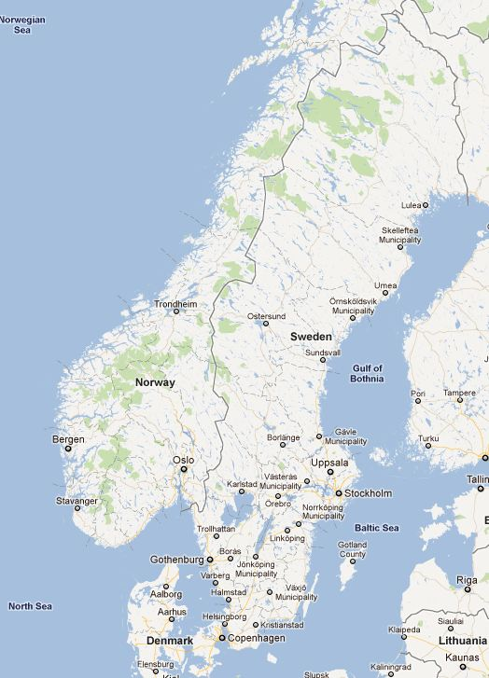
Trip report: Visit to UPPNEX
UPPmax
NExt generation sequencing
Cluster & Storage
University of Uppsala
Uppsala, Sweden
Presented by Hershel Safer
in Ron Shamir’s group meeting
on 16/11/2011

Slide 2
Outline
Background about UPPNEX
Growth in UPPNEX projects
UPPNEX resources
Technical details
Projects under development

Slide 3
SciLifeLab 1
The Science for Life Laboratory (SciLifeLab - www.scilifelab.se) is Sweden’s main center for high-throughput biosciences and translational medicine.
SciLifeLab is a collaboration between four universities:
Stockholm University
Karolinska Institute
Royal Institute of Technology (KTH)
Uppsala University
2 sites: Stockholm & Uppsala
Notes:
The Stockholm site is in a new office building near the Karolinska Institute

Slide 4
SciLifeLab 2
Platforms
Genomics
Proteomics
Bioimaging & functional biology
Comparative genetics
Research programs (intramural and extramural)
Biology
Medicine
Environmental sciences
>100 research groups

Slide 5
How to manage all the data?
Need to support at least:
Immediate use (initial analysis)
Short-term storage (ongoing analysis)
Long-term archive
Collaboration (intra- and inter-institute)

Slide 6
UPPNEX
UPPNEX (www.uppnex.uu.se) is a national resource that provides computing and storage resources for the Next Generation Sequencing (NGS) community in Sweden. It was founded in 2009.
UPPNEX is a project of the Uppsala Multidisciplinary Center for Advanced Computational Science (UPPMAX - www.uppmax.uu.se). UPPMAX was founded in 2003.
UPPMAX is one of six centers in the Swedish National Infrastructure for Computing (SNIC - www.snic.vr.se), a national strategic resource to support high-performance computing in Sweden’s academic research community.

Slide 7
The visit
On 12/9/11, I spent the morning at UPPNEX and the afternoon at SciLifeLab Stockholm.
My goal was to learn how they support inter-institute data transfer and data management, and to bring back information that we can use for our projects.
At UPPNEX, I was hosted by:
Martin Dahlӧ, who works with bioinformatics applications
Samuel Lampa, who works with computing systems
Notes:
I visited because of upcoming needs to support inter-institute data management for NGS as part of I-Core.

Slide 8
Outline
Background about UPPNEX
Growth in UPPNEX projects
UPPNEX resources
Technical details
Projects under development

Slide 9
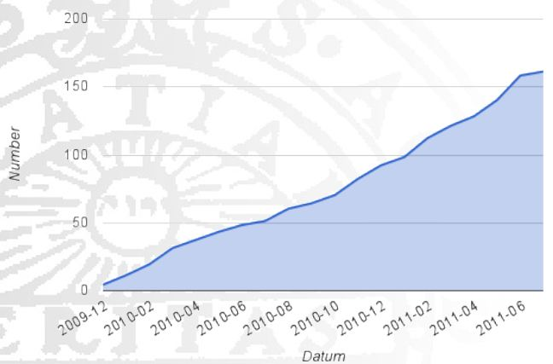
Number of projects

Slide 10
Current projects (July 2011)
University | # projects
uu.se | 58
ki.se | 19
scilifelab.se | 13
slu.se | 9
kth.se | 4
su.se | 4
umu.se | 3
gu.se | 2
liu.se | 1
lu.se | 1
Total | 161

Slide 11
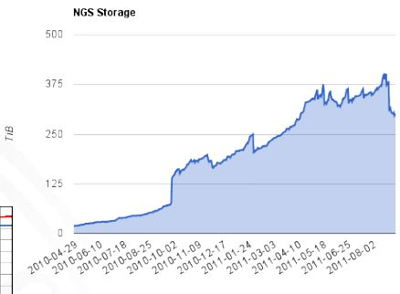
Storage use

Slide 12
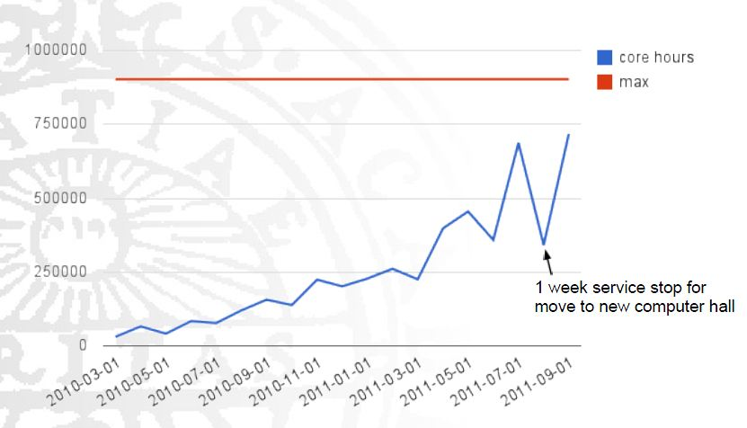
CPU use (core hours / month)

Slide 13
Community
UPPNEX – SciLifeLab Bioinformatics Forum: Monthly meeting to discuss computing questions and issues
SNIC – UPPMAX User Meetings: Hands-on presentations about how to use UPPNEX resources
E-mail lists:
UPPNEX users
Bioinformatics support (planned)
UPPMAX support
Online knowledge base

Slide 14
Outline
Background about UPPNEX
Growth in UPPNEX projects
UPPNEX resources
Technical details
Projects under development

Slide 15
Staffing
Bioinformatics applications
UPPNEX has 1.5 FTEs (2 people)
Another 6 application experts are available to help
Systems
UPPNEX has 1 FTE
UPPMAX has 5.5 FTEs. They help with UPPNEX.
Overall, UPPNEX is using 2-3 FTEs for systems.
Scientific coordinator: 1 person @ 50%

Slide 16
National computing resources
SweStore: “Infinite” space for archiving – cheaper, slower storage for large-scale projects in all areas of science
SUNet: 10 GB inter-university network
SweGrid: SNIC’s grid-based computer and storage system. High-energy physics gets 1/3 of it; the rest is assigned to other areas on a peer-review basis.

Slide 17
UPPNEX computing resources
SMP computer with 64 cores, 2 TB RAM
900k core hours / month in UPPMAX’s Kalkyl computing cluster
~420 TB cluster-attached parallel storage for short-term work
SweStore: Currently using >1 PB (10^15) of space, and growing

Slide 18
Money
Funding
Initial funding from a private foundation
Personnel support from SNIC
Charges
Users are not currently charged for storage space
Each project is initially allocated 0.5 TB
Projects last ~1.5 years, which is longer than expected in the initial plan

Slide 19
Outline
Background about UPPNEX
Growth in UPPNEX projects
UPPNEX resources
Technical details
Projects under development

Slide 20
NGS workflow
Data are initially stored and analyzed locally at SciLifeLab. Thomas Svensson at SciLifeLab Stockholm has a group of ~20 people who deal with data analysis.
After initial analysis, data are transferred to UPPNEX over SUNet. At present, transfers are initiated manually.
Data are stored at UPPNEX for ongoing analysis. Access to each project is restricted to authorized users.
Job scheduling is done with SLURM.
After analysis is complete, data are archived to SweStore.

Slide 21
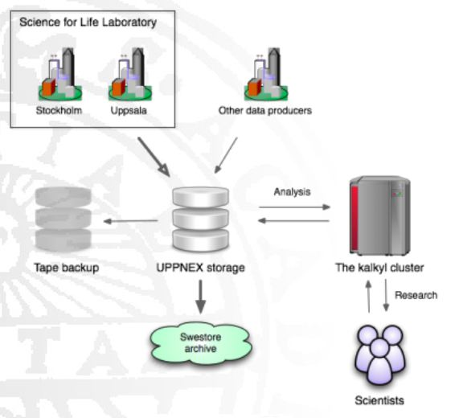
Architecture

Slide 22
Cluster configuration 1
Linux: Currently Scientific Linux (based on RedHat). Possibly moving to Rocks Clusters for convenient installation.
RAM: UPPMAX Kalkyl cluster has 24 GB / node => 3 GB / core. Some NGS jobs, such as assembly, need much more. Purchased dedicated machine with 2 TB memory.
Storage: Parallel file system to obviate need to copy files to / from local storage.
Connectivity: Infiniband to facilitate inter-node communication. This is expensive and superfluous for bioinformatics – we don’t do much work that requires this capability.

Slide 23
Cluster configuration 2
Security issues with software (e.g., Galaxy) that runs as a single server process and is used by multiple users:
The software needs to access each user’s protected files.
It therefore needs to be run as root (very dangerous), be able to suid to any user (dangerous), or be a member of all the projects’ groups (insecure).
They are trying various ways to grapple with this.

Slide 24
Issues
Data growth is much faster than expected
Data duplication
Too much manual intervention in data management
Users (biologists) need help with Linux data-management tools
More interactive style of working than many other UPPMAX users, such as physicists. Allows possibility of sharing workload.

Slide 25
Outline
Background about UPPNEX
Growth in UPPNEX projects
UPPNEX resources
Technical details
Projects under development

Slide 26
Upcoming systems for automated data transfer
Data transfer from sequencing machines to UPPNEX storage
Their solution is based on the Blue Collar Bioinformatics (bcbb) package by Brad Chapman at the Harvard School of Public Health. They have their own fork of bcbb.
Data transfer between fast storage and cheap storage
Installing iRODS for automated, policy-based data migration between fast storage (UPPNEX servers) and cheaper storage (SweStore)

Slide 27
Bioclipse workbench for working with data
Based on Eclipse
They are among the lead developers of Bioclipse
Features include:
Secure communication using SSH
Job configuration wizard
Graphic interface to command-line tools
Integrated genome viewer
Galaxy integration

Slide 28
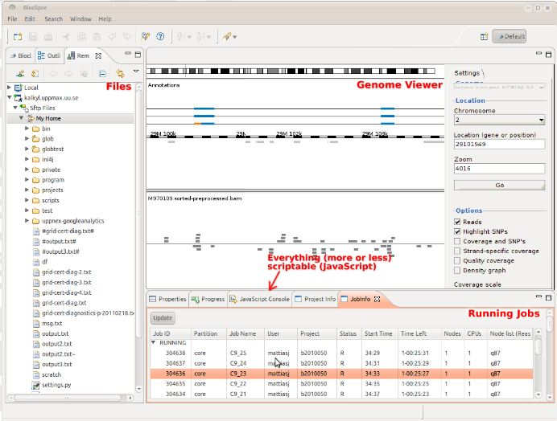
Bioclipse client

Slide 29
Galaxy Web portal
Some results are provided to users via a local Galaxy installation
Web-based interface to command-line tools
Create and run re-usable workflows

Slide 30
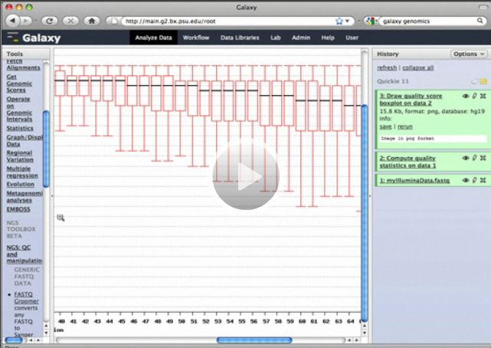
Galaxy in Web browser

Slide 31
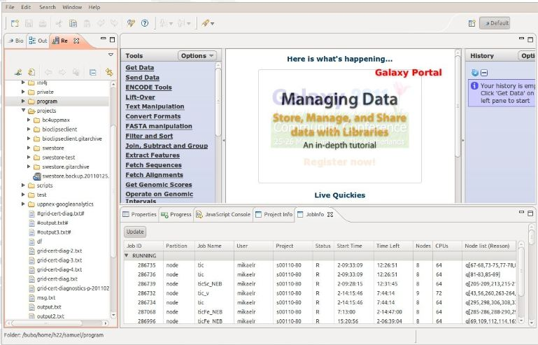
Galaxy in Bioclipse browser

Slide 32
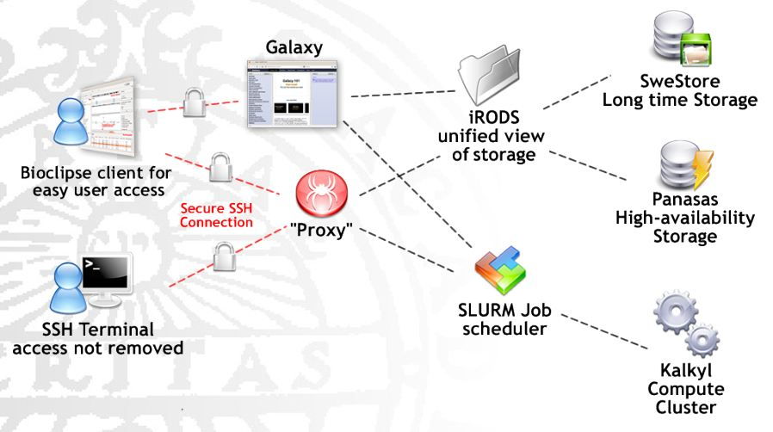
Planned architecture

